Slide 1

Network Models: OSI, DoD and TCP/IP Model
School of Computer Science Engineering and Technology Bennett University
Greater Noida – 201310

Slide 2

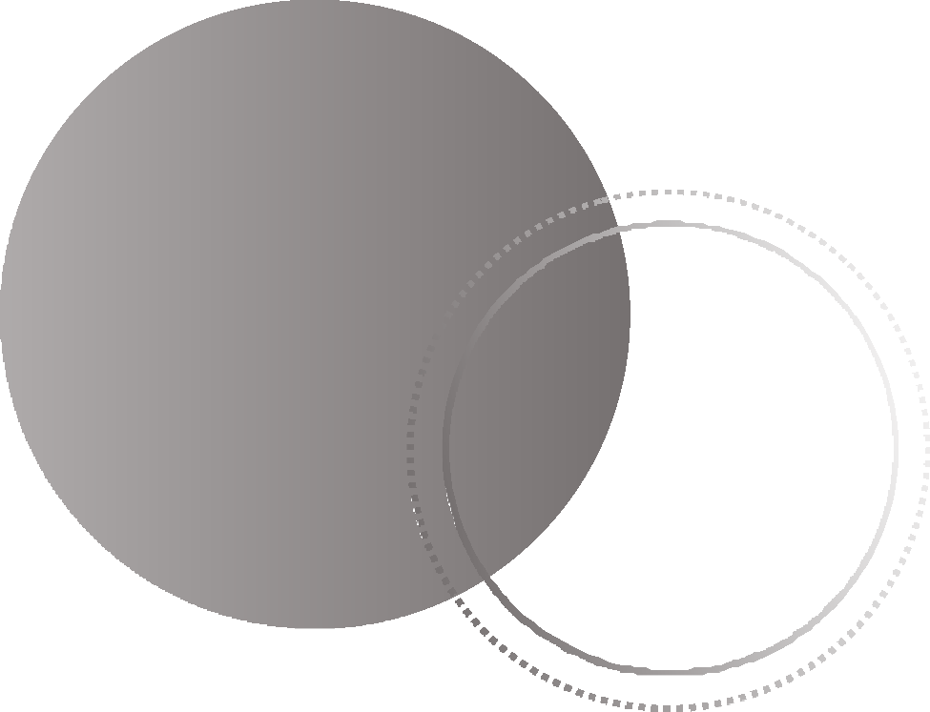

OSI Versus DoD Model
L
Layered Architecture
Outline
TCP/IP Model

Slide 3
Network Model: Layered Architecture
Network model describes the used to
architecture, components, and design
establish communication between the source and destination systems.
A communication system is a complex piece of hardware and software.
A with many interacting components is
single, complex, unstructured program
very difficult to test and modify.
To overcome such problem, the ISO has developed a layered approach.

Slide 4
Network Model: Layered Architecture
Why do we require Layered architecture?
Divide-and-conquer approach: It divides the unmanageable tasks into small and manageable
tasks and reduces the complexity.
Modularity: Layered architecture is more modular. Modularity provides the independence of
layers, which is easier to understand and implement.
Easy to modify: It ensures the independence of layers so that implementation in one layer can be changed without affecting other layers.
Easy to test: Each layer of the layered architecture can be analyzed and tested individually.

Slide 5
Network Model: Layered Architecture
In a layered approach, networking concept is divided into several layers, and each layer is assigned a particular task.
Each lower layer adds its services to the higher layer to manage communications and run the applications.
The number of layers, functions, layer contents will vary from network to network.
The purpose of each layer is to provide the service from lower to a higher layer and hiding the implementation details.

Slide 6
Network Model: Layered Architecture
Elements:
Service: It is a set of actions that a layer provides to the higher layer.
Protocol: It defines a set of rules that a layer uses to exchange the information with peer entity.
Interface: It is a way through which the message is transferred from one layer to another layer.
There are 2 predominant models available based on layered approach.
Open Systems Interconnection (OSI) Model
Transmission Control Protocol/Internet Protocol (TCP/IP) Model

Slide 7
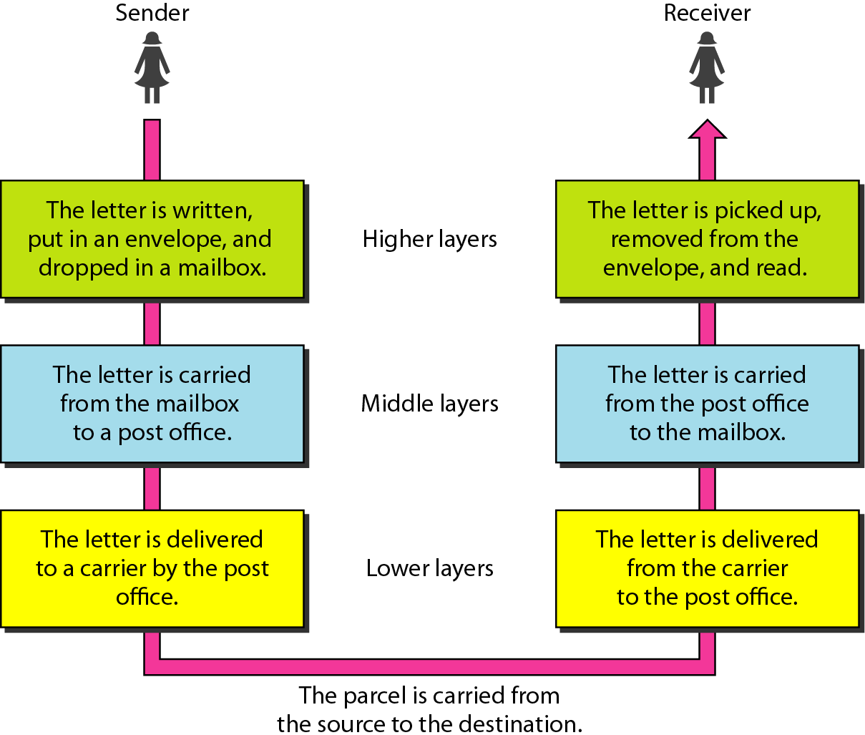
Layered Architecture Example
Networking devices
Network types
Network topologies

Slide 8
Network Model: OSI Model
OSI is a reference model that describes how information from a software application in one computer moves through a physical medium to the software application in another computer.
It was developed by the International Organization for Standardization (ISO) in 1984.
It divides the whole task into seven smaller and manageable tasks.
Each layer is self-contained, and task assigned to the layer can be performed independently.

Slide 9
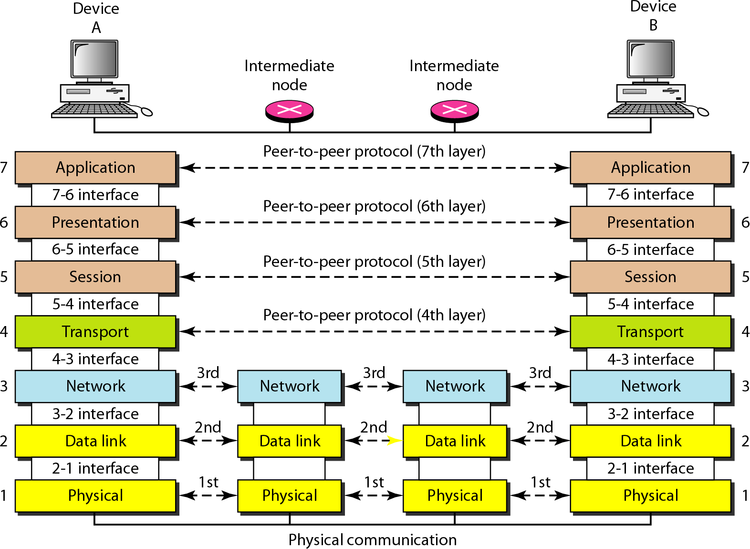
Interaction between the layers

Slide 10
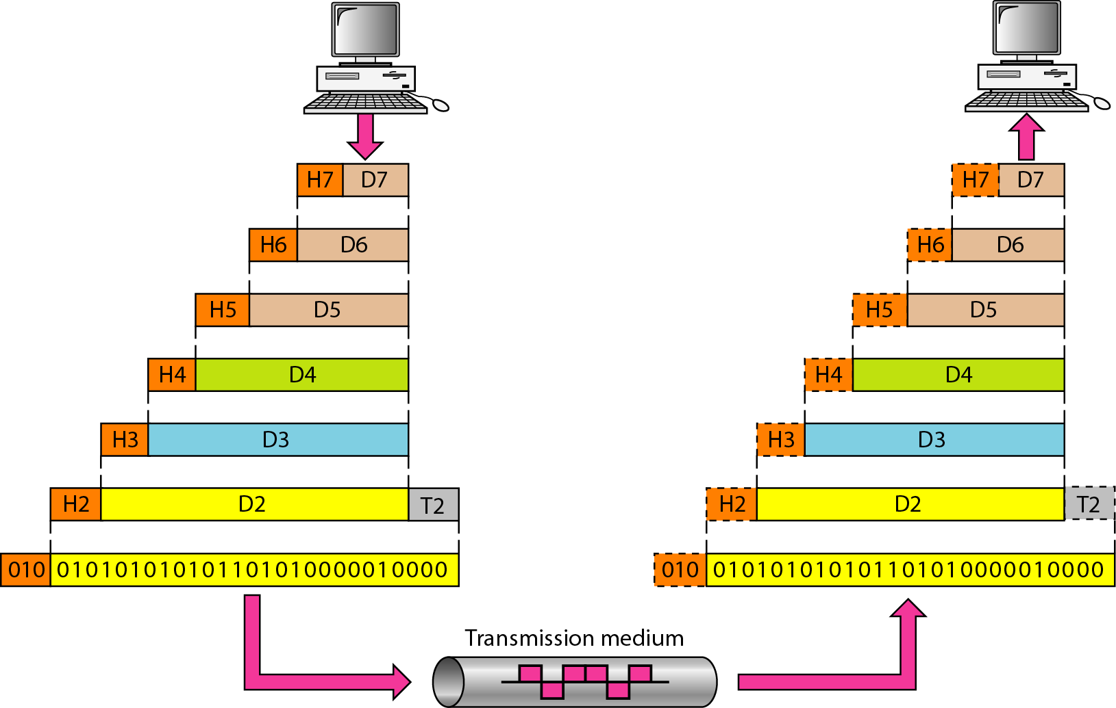
Exchange using OSI Model

Slide 11
OSI Model: Physical Layer
Physical layer transmits the individual bits from one node to another node.
It is the lowest layer of the OSI model.
It establishes, maintains and deactivates the physical connection.
Hub, Repeater, Modem, Cables are Physical Layer devices.
Functions:
Line Configuration: It defines the way how two or more devices can be connected physically.
Data Transmission: It defines the transmission mode between two devices on the network.
Topology: It defines the way how network devices are arranged.
Signals: It determines the type of the signal used for transmitting the information.

Slide 12
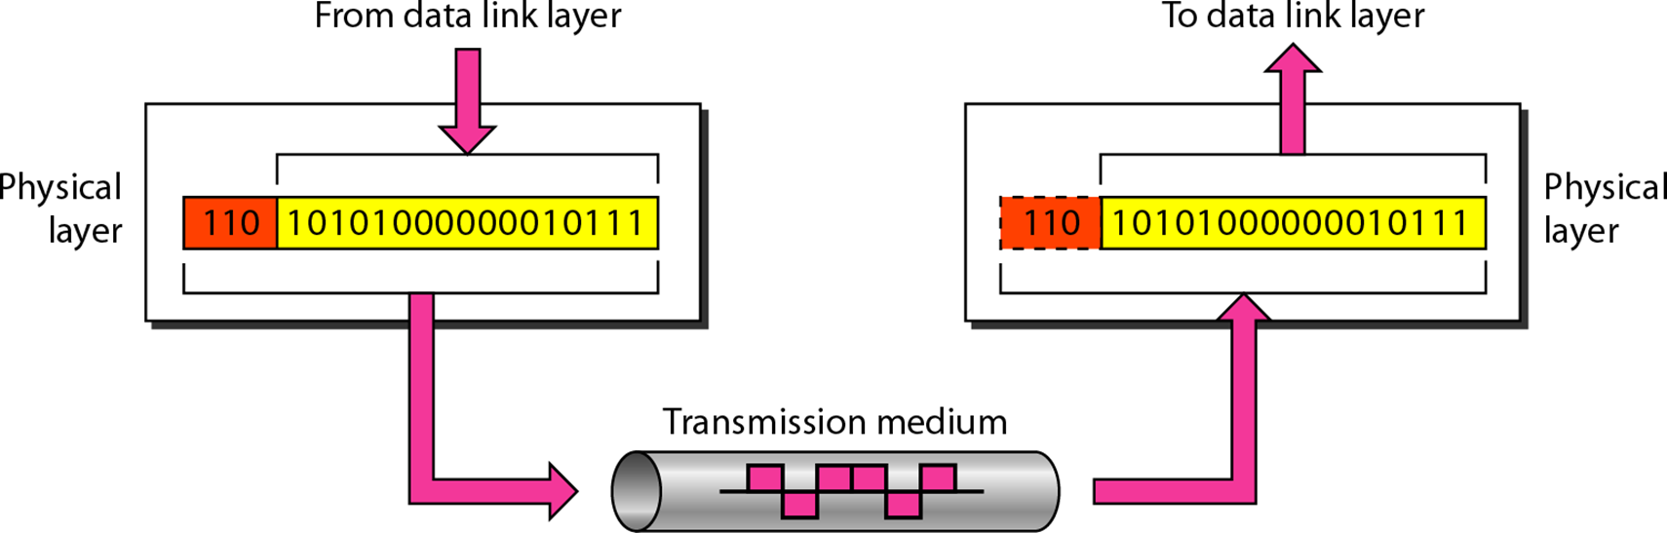
OSI Model: Physical Layer

Slide 13
OSI Model: Data Link Layer
Packet in Data Link layer is referred to as Frame.
Responsible for the error-free transfer of data frames.
It provides a reliable and efficient communication between two or more devices.
Provides unique identification of each device that resides on a local network.
Data Link layer is handled by the NIC (Network Interface Card) and device drivers of host machines.
Switch & Bridge are Data Link Layer devices.
It contains two sub-layers:
Logical Link Control Layer: Transfer the packets to the Network layer and provides flow control.
Media Access Control Layer: Provides link between the Logical Link Control layer and the network's
physical layer and is used for transferring the packets over the network.

Slide 14
OSI Model: Data Link Layer
Functions:
Framing: Conversion from raw bit stream into packets. Frame contains header, packets and trailer
Physical Addressing: Providing address to source and destination device.
Flow Control: Technique through which the constant data rate is maintained on both the sides so that
no data get corrupted.
Error Control: Error control is achieved by adding a calculated value CRC (Cyclic Redundancy Check)
Access Control: Used to determine which device has control over the shared link at a given time.

Slide 15
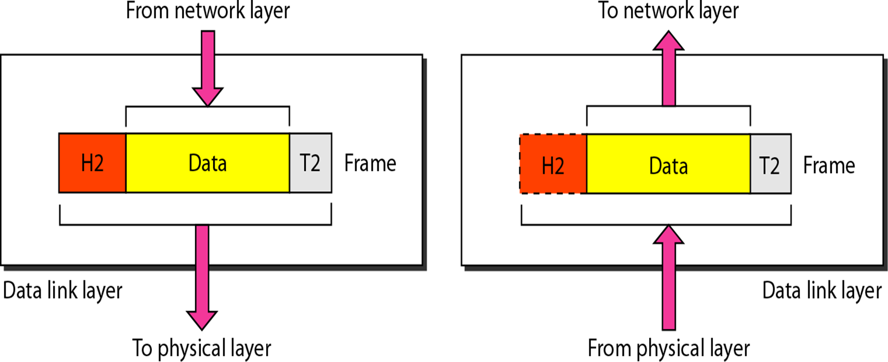
OSI Model: Data Link Layer

Slide 16
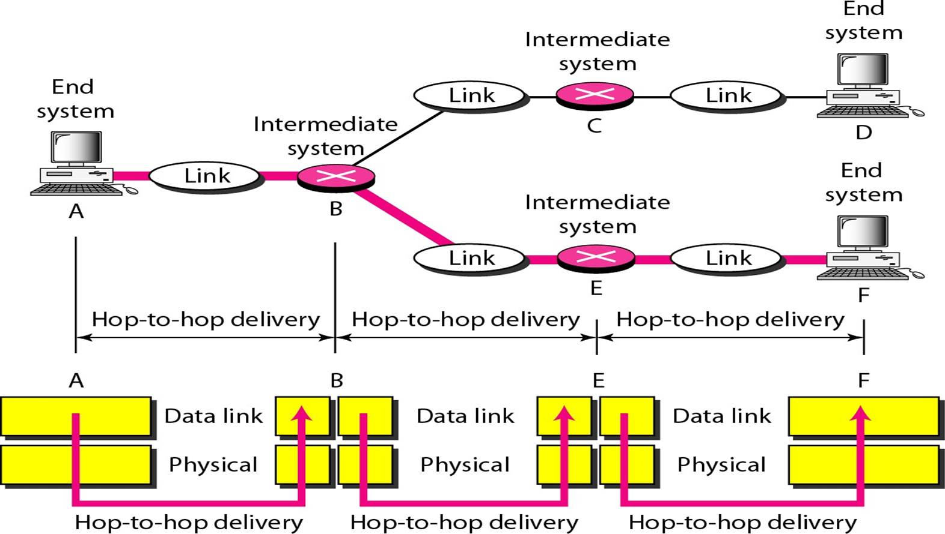
OSI Model: Data Link Layer

Slide 17
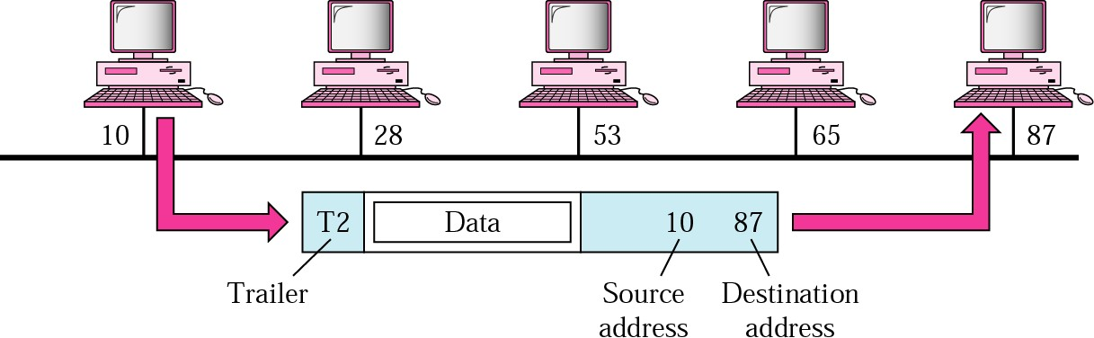
OSI Model: Data Link Layer
Example:
In following Figure, a node with physical address 10 sends a frame to a node with physical address 87. At the data link level this frame contains physical addresses in the header. The trailer usually contains extra bits needed for error detection

Slide 18
OSI Model: Network Layer
It manages device addressing, tracks the location of devices on the network.
It determines the best path to move data from source to the destination based on the network
conditions, the priority of service, and other factors.
Routers are used to provide the routing services within an internetwork.
The protocols used to route the network traffic are IPv4 and Ipv6.

Slide 19
OSI Model: Network Layer
Functions:
Internetworking: Provides a logical connection between different devices.
Addressing: Source and destination address are added to the header of the frame to identify the device on the internet.
Routing: It determines the best optimal path out of the multiple paths from source to the destination.
Packetizing: Process of converting the upper layer data into packets using Internet protocol (IP).
Congestion control

Slide 20
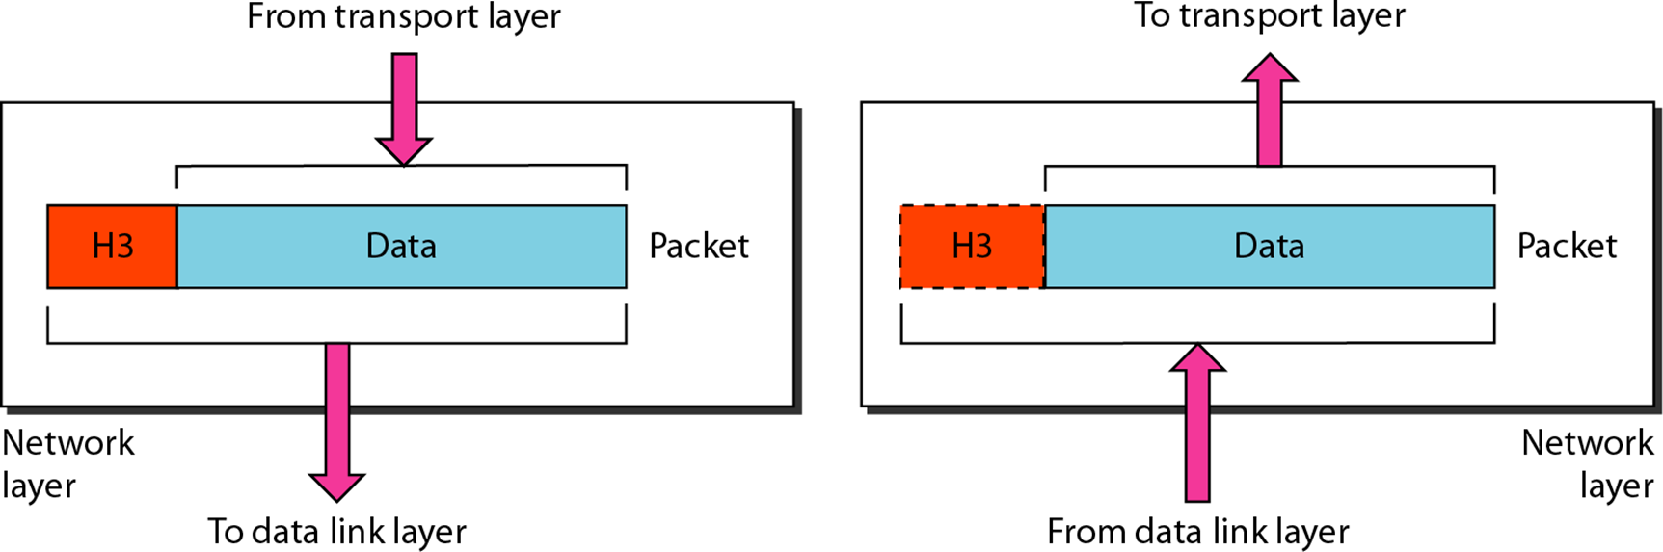
OSI Model: Network Layer

Slide 21
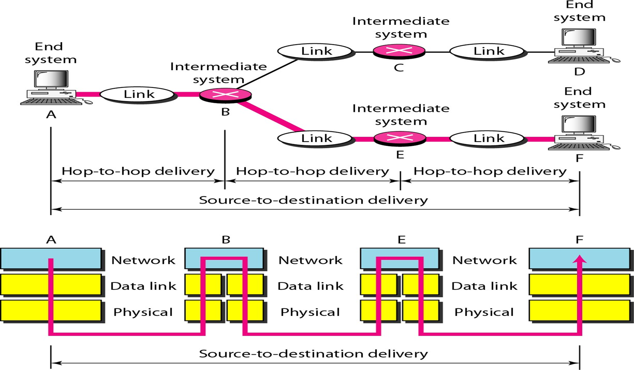
OSI Model: Network Layer

Slide 22
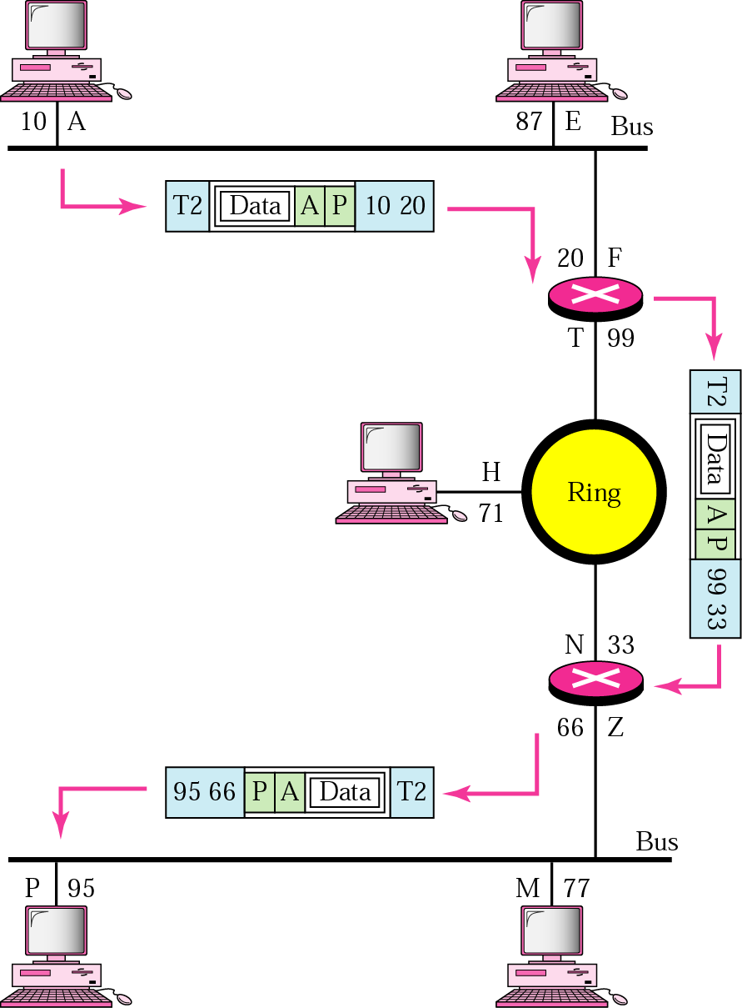
OSI Model: Network Layer
Example:
We want to send data from a node with network address A and physical address 10, located on one LAN, to a node with a network address P and physical address 95, located on another LAN. Because the two devices are located on different networks, we cannot use physical addresses only; the physical addresses only have local
influence. What we need here are
universal addresses
(network/logical address)
that can pass through the
LAN boundaries.

Slide 23
OSI Model: Transport Layer
It ensures that messages are transmitted in the order in which they are sent and there is no duplication of data.
The main responsibility of the transport layer is to transfer the data completely.
It receives the data from the upper layer and converts them into smaller units known as segments.
This layer can be termed as an end-to-end layer as it provides a point-to-point connection between source and destination to deliver the data reliably.
It is a part of the OS and communicates with the Application Layer by making system calls.
It is called as Heart of OSI model.
Protocols: Transmission Control Protocol and User Datagram Protocol

Slide 24
OSI Model: Transport Layer
Function:
Service-point addressing: The header that contains the address known as a service-point address or port address to transmit the message to the correct process.
Segmentation and reassembly: Message is divided into multiple segments with a unique segment number at sender side and reassembled at the destination side based on their sequence numbers.
Connection control: Provide Connection-oriented service and connectionless service.
Flow control: Performed end-to-end rather than across a single link.
Error control: The sender transport layer ensures that message reach at the destination without
error.

Slide 25
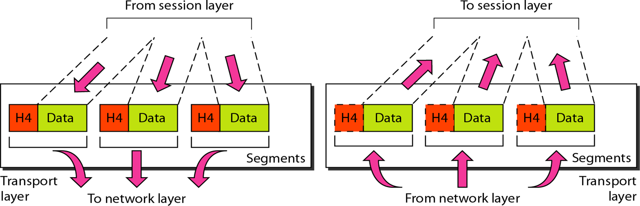
OSI Model: Transport Layer

Slide 26
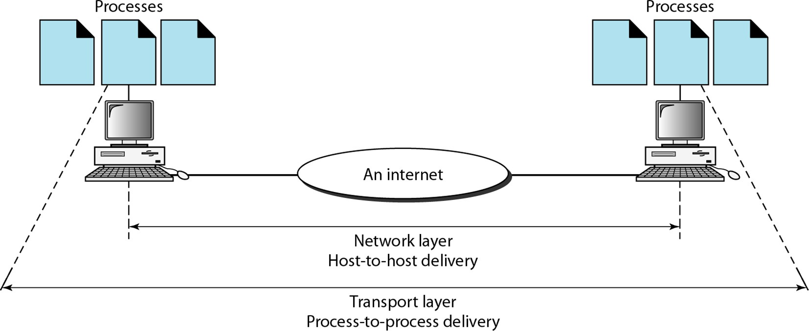
OSI Model: Transport Layer

Slide 27
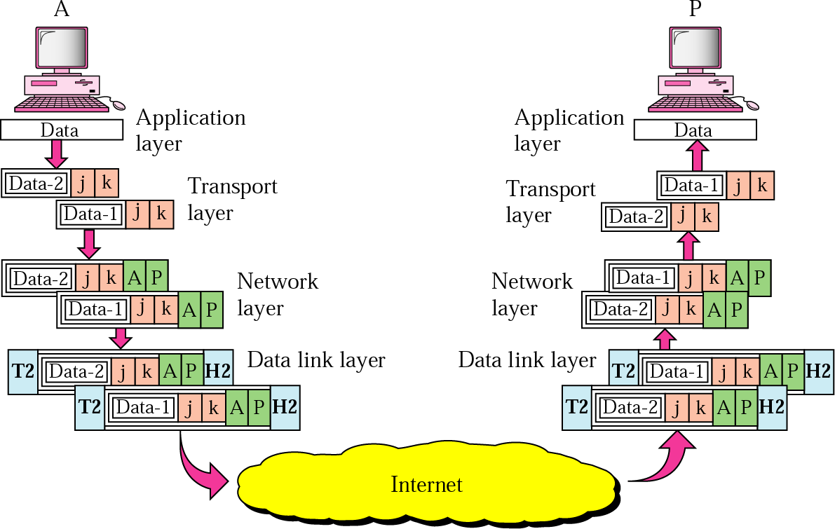
OSI Model: Transport Layer
Example:
Data coming from the upper layers
have port addresses
j and k (j is the
address of the sending process, and
k is the address of the receiving
process)
. Since the data size is
larger than the network layer can handle, the data are split into two packets, each packet retaining the port addresses (j and k). Then in the network layer, network addresses (A and P) are added to each packet.

Slide 28
OSI Model: Session Layer
It is used to establish, maintain and synchronizes the interaction between communicating devices.
Functions:
Authentication: Once a user logs in, he/she should remain logged in until he/she logs out.
Authorization: Access rights to specific parts of a website are given to super-users and admins.
Dialog Control: Allows various systems running applications like WebEx to communicate.
Synchronization: It ensures the timestamps of the audio and video received are in the right order.

Slide 29
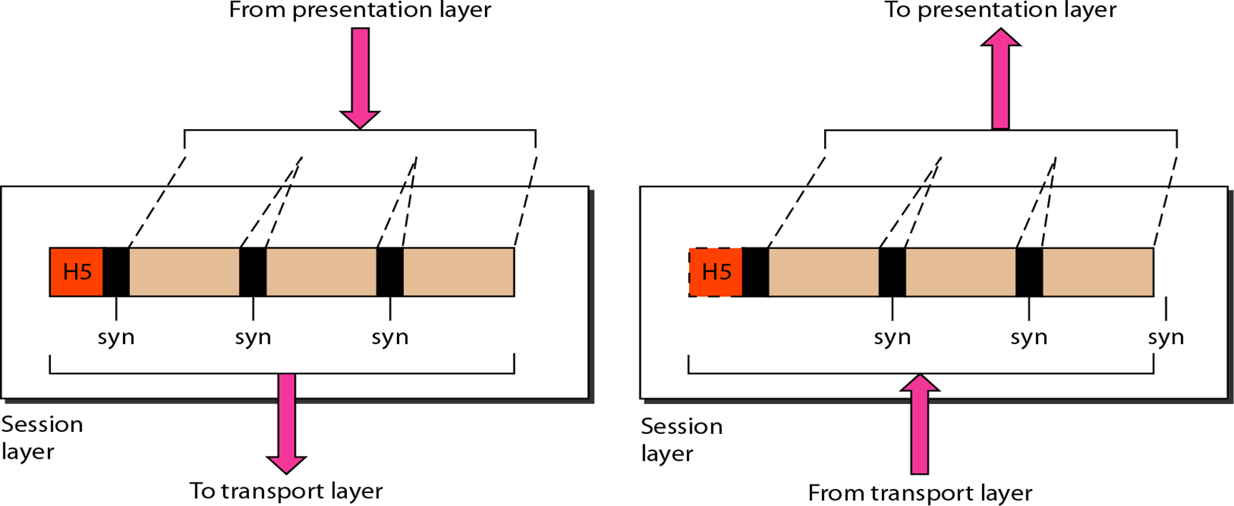
OSI Model: Session Layer

Slide 30
OSI Model: Presentation Layer
It is concerned with the syntax and semantics of the information exchanged between the two
systems, so it is called as syntax layer
It acts as a data translator for a network.
It converts the data from one presentation format to another format.
Functions:
Translation: It handles the interoperability between the different encoding methods.
Encryption: A process of converting the sender-transmitted information into another form and sends the
resulting message over the network.
Compression: A process of compressing the data, i.e., it reduces the number of bits to be transmitted.

Slide 31
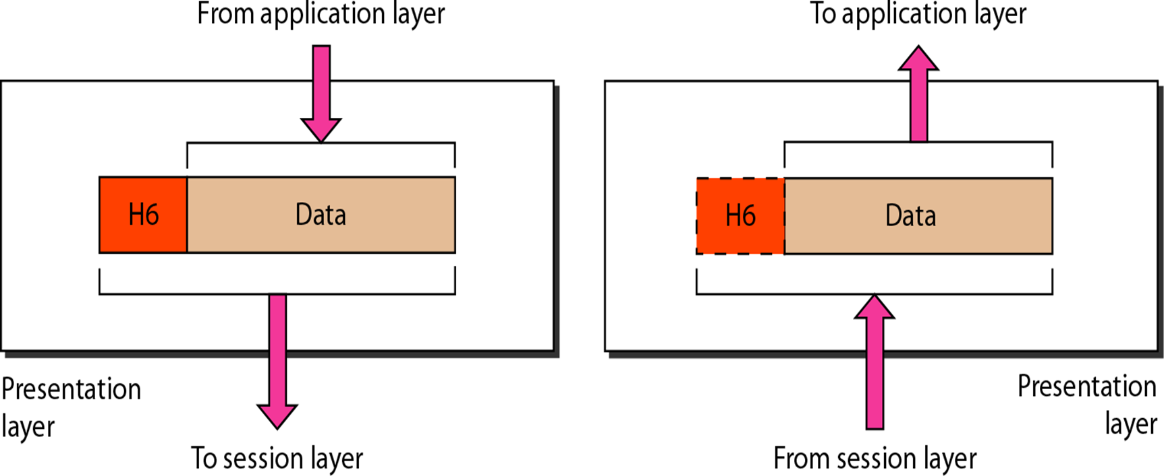
OSI Model: Presentation Layer

Slide 32
OSI Model: Application Layer
It serves as a window for users and application processes to access network service.
It handles issues such as network transparency, resource allocation, etc.
This layer provides the network services to the end-users.
Application Layer is also called Desktop Layer.
Functions of Application layer:
File transfer, access, and management (FTAM): Allows a user to manage files in a remote computer.
Mail services: Provides the facility for email forwarding and storage.
Directory services: An application provides the distributed database sources and is used to provide that global
information about various objects.

Slide 33
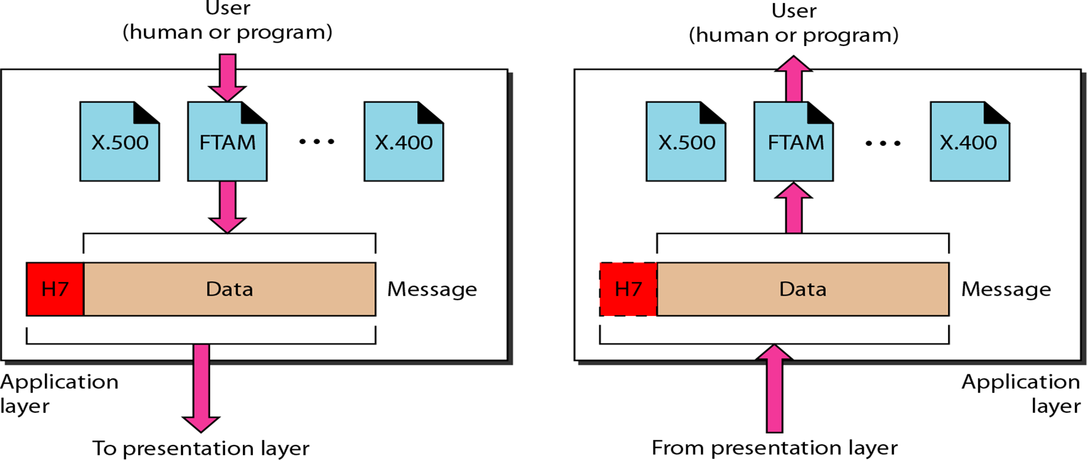
OSI Model: Application Layer

Slide 34
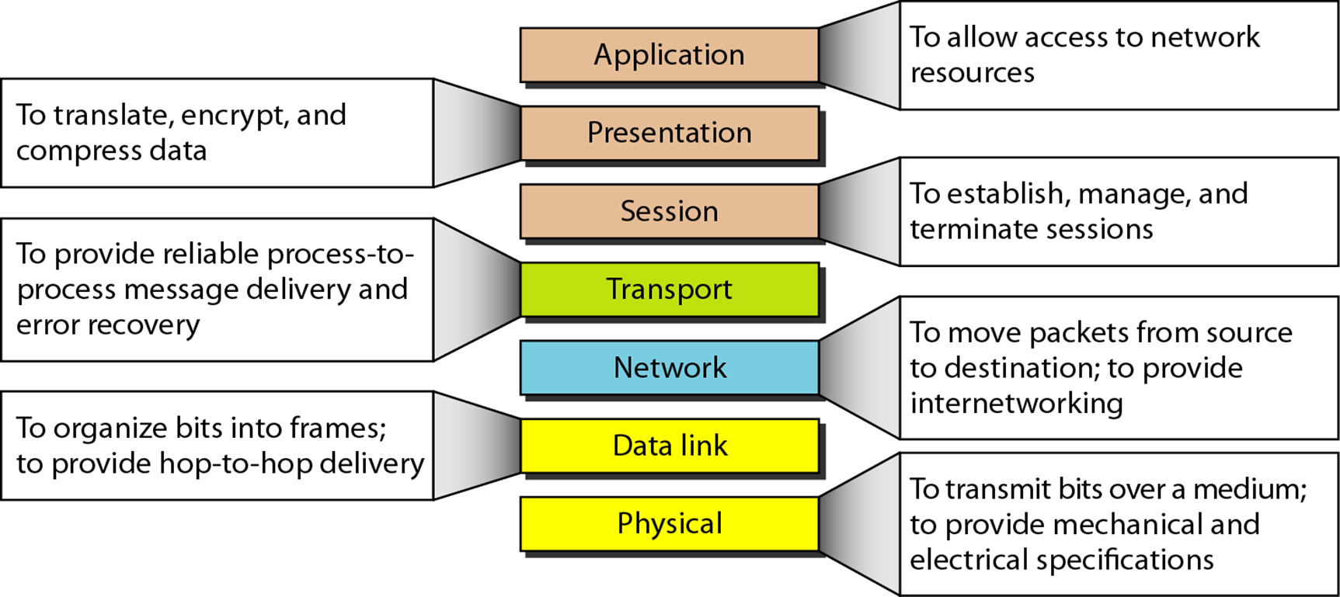
OSI Model: Summary

Slide 35
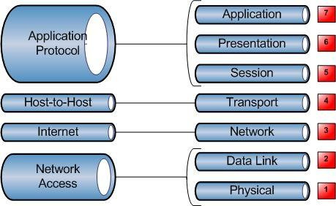
OSI and DoD Model
The DoD model is a condensed version of the OSI model—it's composed of four, instead of seven, layers.
A vast array of protocols combine at the DoD model's Process/Application layer to integrate the various activities and duties spanning the focus of
the OSI's (Application,
corresponding Presentation,
top three layers and Session). The
Process/Application layer defines protocols for node-to-node application communication and also controls user-interface specifications.

Slide 36
OSI and DoD Model II
The Host-to-Host layer parallels the functions of the OSI's Transport layer, defining protocols for setting up the level of transmission service for applications. It tackles issues such as creating reliable end-to-end communication and ensuring the error-free delivery of data. It handles packet sequencing and maintains data integrity.
The Internet layer corresponds to the OSI's Network layer, designating the protocols relating to the logical transmission of packets over the entire network. It takes care of the addressing of hosts by giving them an Internet Protocol (IP) address, and it handles the routing of packets among multiple networks.

Slide 37
OSI and DoD Model III
At the bottom of the DoD model, the Network Access layer implements the data exchange between the host and the network. The equivalent of the Data Link and Physical layers of the OSI model, the Network Access layer oversees hardware addressing and defines protocols for the physical transmission of data.

Slide 38
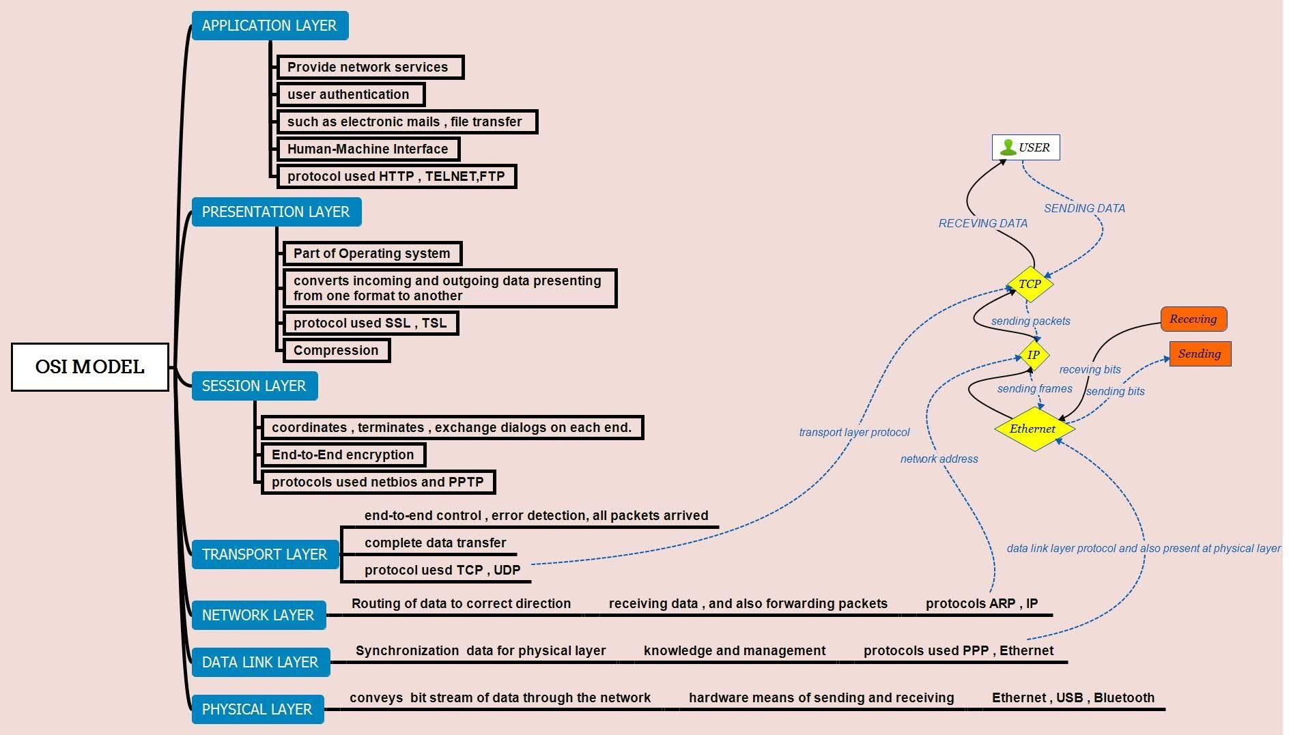
OSI Model: Protocol and Specification Layout

Slide 39
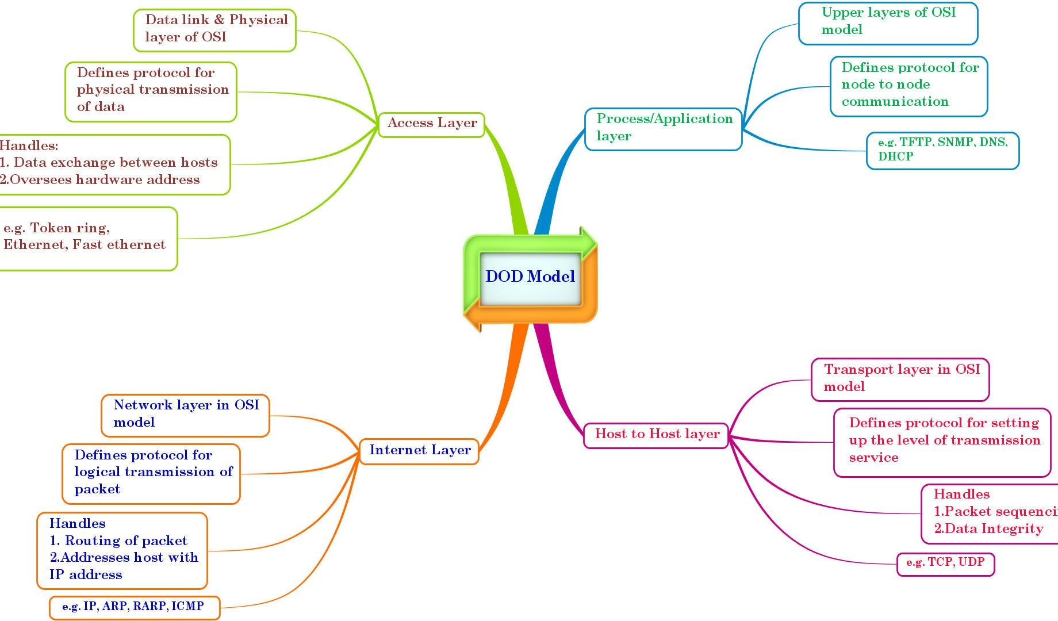
DoD Model: Protocol and Specification Layout

Slide 40
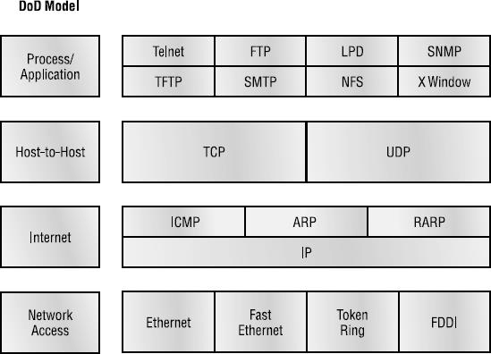
TCP/IP Network Model
The DoD and OSI models are alike in design and concept and have similar functions in similar layers. Figure shows the TCP/IP protocol suite and how its protocols relate to the DoD model layers.
TCP/IP Reference Model is a four-layered suite of communication protocols. It was developed by the DoD (Department of Defense) in the 1970s-80s. It is named after the two main protocols that are used in the model, namely, TCP and IP. TCP stands for Transmission Control Protocol and IP stands for Internet Protocol.

Slide 41
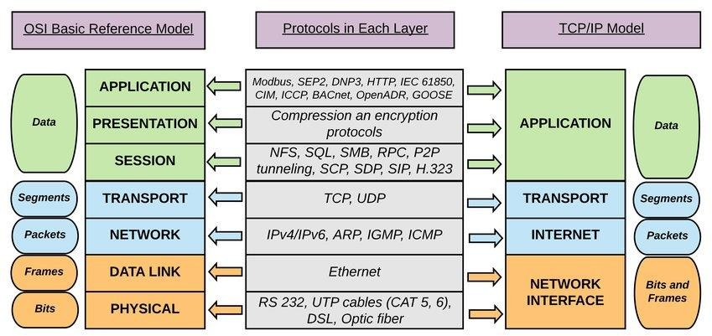
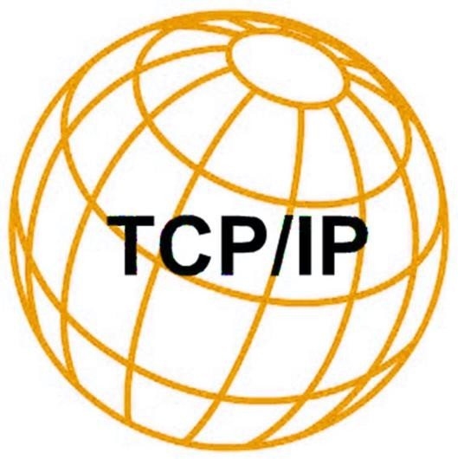
TCP/IP Protocol Stack

Slide 42
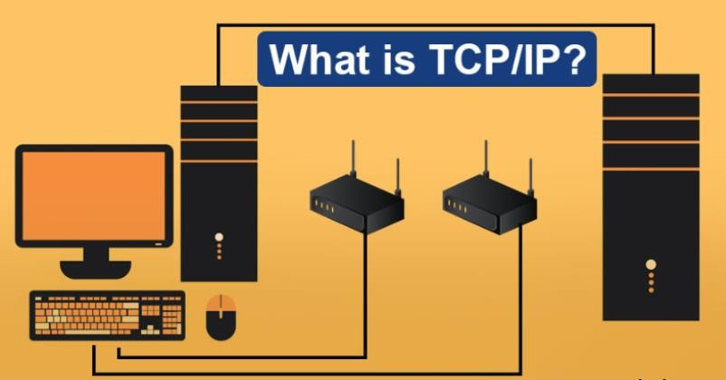

Slide 43
The name TCP/IP refers to a suite of data communication protocols. The name is misleading because TCP and IP are only two of dozens of protocols that compose the suite. Its name comes from two of the more important protocols in the suite: the Transmission Control Protocol (TCP) and the Internet Protocol (IP).
TCP/IP originated out of the investigative research into networking protocols that the Department of Defense (DoD) initiated in 1969. In 1968, the DoD Advanced Research Projects Agency (ARPA) began researching the network technology that is now called packet switching.
The original focus of this research was to facilitate communication among the DoD community. However, the network that was initially constructed as a result of this research, then called ARPANET, gradually became known as the Internet. The TCP/IP protocols played an important role in the development of the Internet. In the early 1980s, the TCP/IP protocols were developed. In 1983, they became standard protocols for ARPANET.
Because of the history and resemblance of the TCP/IP protocol suite, it is often referred to as the DoD protocol suite or the Internet protocol suite.

Slide 44

Physical + Data Link Layer
The design of TCP/IP hides the function of this layer from users--it is concerned with getting data across a specific type of physical network (such as Ethernet, Token Ring, etc.).
This design reduces the need to rewrite higher levels of a TCP/IP stack when new physical network technologies are introduced (such as ATM and Frame Relay).
The functions performed at this level include encapsulating the IP datagrams into frames that are transmitted by the network. It also maps the IP addresses to the physical addresses used by the network.
IP address must be converted into whatever address is appropriate for
the physical network over which the datagram is transmitted.
Data to be transmitted is received from the internetwork layer. The network access layer is responsible for routing and must add its routing information to the data. The network access layer information is added in the form of a header, which is appended to the beginning of the data.

Slide 45
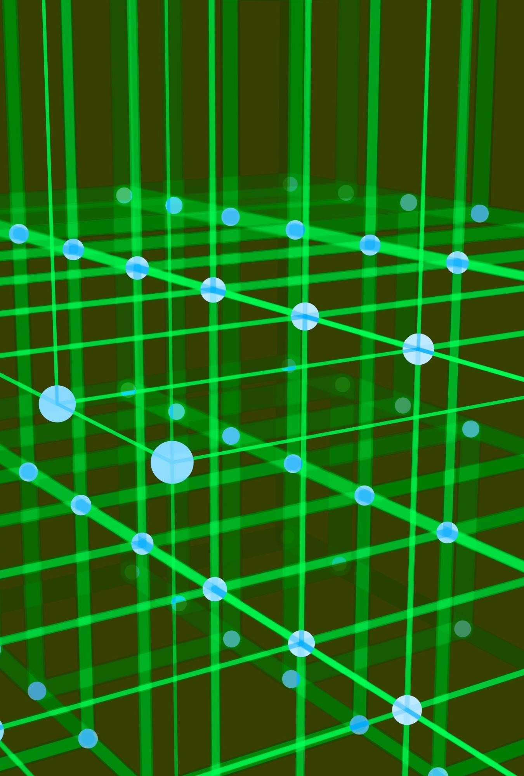
Network Layer
This layer is responsible for routing messages through internetworks. Two types of devices are responsible for routing messages between networks. The first device is called a gateway, which is a computer that has two network adapter cards.
Gateway accepts network packets from one network on one network card and routes those packets to a different network via the second network adapter card. The second device is a router, which is a dedicated hardware device that passes packets from one network to a different network. These two terms are often used interchangeably, but distinct differences exist in their ability to route packets.
The internetwork layer protocols provide a datagram network service. Datagrams are packets of information that comprise a header, data, and a trailer. The header contains information, such as the destination address, that the network needs to route the datagram. A header can also contain other information, such as the source address and security labels. Trailers typically contain a checksum value.

Slide 46
Network Layer II
The communicating entities--which can be computers, operating systems, programs, processes, or people--that use the datagram services must specify the destination address (using control information) and the data for each message to be transmitted. The network layer protocols package the message in a datagram and send it off.
A datagram service does not support any concept of a session or connection. Once a message is sent or received, the service retains no memory of the entity with which it was communicating. If such a memory is needed, the protocols in the host-to-host transport layer maintain it. The abilities to retransmit data and check it for errors are minimal or nonexistent in the datagram services. If the receiving datagram service detects a transmission error during transmission using the checksum value of the datagram, it simply ignores (or drops) the datagram without notifying the receiving higher-layer entity.

Slide 47

It is responsible for providing end-to-end data integrity and provides a highly reliable
communication service for entities that want to
carry out an extended two-way conversation.
In addition to the usual transmit and receive functions, the transport layer uses open and close commands to initiate and terminate the connection. This layer accepts information to be transmitted as a stream of characters, and it returns information to the recipient as a stream.
The service employs the concept of a connection (or virtual circuit). A connection is the state of the host-to-host transport layer between the time
Transport/ Host-to-Host
Layer
that an open command is accepted by the receiving computer and the time that the close command is issued by either computer.

Slide 48

Application Layer
This layer provides functions for users or their programs, and it is highly specific to the application being performed. It provides the services that user applications use to communicate over the network, and it is the layer in which user-access network processes reside.
These processes include all of those that users interact with directly, as well
as other processes of which the users are not aware.
This layer includes all applications protocols that use the host-to-host transport protocols to deliver data. Other functions that process user data, such as data encryption and decryption and compression and decompression, can also reside at the application layer.
The application layer also manages the sessions (connections) between cooperating applications. In the TCP/IP protocol hierarchy, sessions are not identifiable as a separate layer, and these functions are performed by the host-to-host transport layer. Instead of using the term "session," TCP/IP uses the terms "socket" and "port" to describe the path (or virtual circuit) over which cooperating applications communicate.

Slide 49
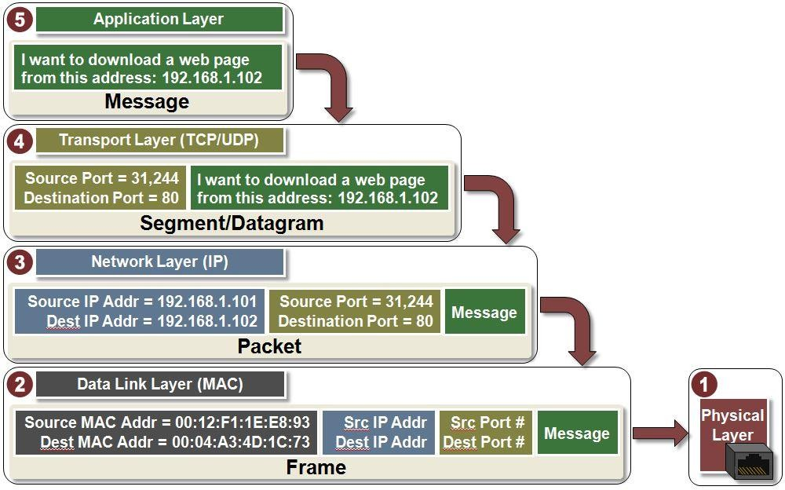
TCP/IP
Reference Example (Layers)

Slide 50
Further Study
(For Students)
Difference between TCP/IP and OSI reference Models.
ARPANET Packet Switching Network and DoD Model
Pros and Cons of TCP/IP
What is NetBEUI or IPX/SPX ?

Slide 51
References
https://datatracker.ietf.org/doc/html/rfc1180
https://datatracker.ietf.org/doc/html/rfc793
https://datatracker.ietf.org/doc/html/rfc791
❖
https://www.cisco.com/c/en/us/support/docs/i p/routing-information-protocol-rip/13769- 5.html
https://www.cisco.com/E-
Learning/bulk/public/tac/cim/cib/using_cisco
_ios_software/linked/tcpip.htm
❖
https://www.juniper.net/documentation/en_U S/junose15.1/topics/concept/ip- overview.html
❖
https://www.juniper.net/documentation/us/en/ software/junos/flow-packet- processing/topics/topic-map/security-tcp- session-checks.html

